Slide 1
Instructor Materials Chapter 1 Ever Wonder How It Works?
Networking Essentials
Notes:
Cisco Networking Academy Program
Networking Essentials
Chapter 1: Ever Wonder How It Works?

Slide 2
Instructor Materials - Chapter 1 Planning Guide
This PowerPoint deck is divided in two parts:
Instructor Planning Guide
Information to help you become familiar with the chapter
Teaching aids
Instructor Class Presentation
Optional slides that you can use in the classroom
Begins on slide # 8
Note:
Remove the Planning Guide from this presentation before sharing with anyone.
Notes:
2

Slide 3
Networking Essentials
Instructor Planning Guide
Chapter 1: Ever Wonder How It Works?
Notes:
Networking Essentials
Chapter 1: Ever Wonder How It Works?

Slide 4
Chapter 1: Activities
What activities are associated with this chapter?
Page # | Activity Type | Activity Name
1.1.1.3 | Interactive Activity | Identify Appropriate Definition
1.2.1.3 | Interactive Activity | Network Components
1.3.1.2 | Interactive Activity | Identify Computer Roles
1.3.1.3 | Lab | Tracing Internet Connectivity
1.3.1.3 | Lab | Build a Simple Network
Notes:
4

Slide 5
Chapter 1: Assessment
Students should complete Chapter 1, “Assessment” after completing Chapter 1.
Quizzes, labs, Packet Tracers and other activities can be used to informally assess student progress.
Notes:
5

Slide 6
Chapter 1: Additional Help
For additional help with teaching strategies, including lesson plans, analogies for difficult concepts, and discussion topics, visit the Facebook page for community and peer support at the following: www.facebook.com/cisconetworkingacademy.
Notes:
6

Slide 7


Slide 8
Chapter 1: Ever Wonder How It Works?
Networking Essentials
Notes:
Cisco Networking Academy Program
Networking Essentials
Chapter 1: Ever Wonder How It Works?

Slide 9
Chapter 1 - Sections & Objectives
1.1 Communicating in a Connected World
Explain the concept of network communication.
1.2 Local Networks
Explain the roles of devices in a network.
1.3 Building a Simple Network
Build a functioning network.
Notes:
9

Slide 11
1.1 Communicating in a Connected World
Notes:
Cisco Networking Academy Program
Networking Essentials
Chapter 1: Ever Wonder How It Works?

Slide 12
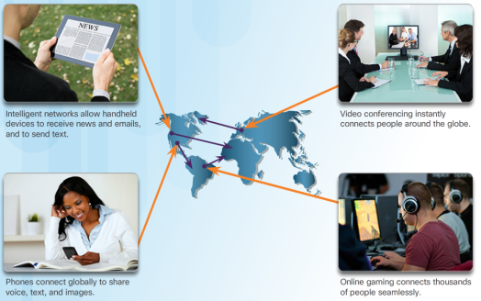
Communicating in a Connected World What is the Network?
Are you Online?
For most of us, the Internet has become a large part of everyday life.
Who owns the Internet?
No one owns the Internet.
It is a worldwide collection of interconnected networks exchanging information using common standards over telephone wires, fiber-optic cables, wireless transmissions, and satellite links.
Notes:
1.1 – Communicating in a Connected World
1.1.1 – What is the Network?

Slide 14
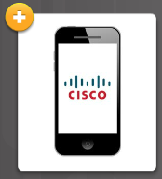



Communicating in a Connected World What is the Network?
Local Networks
Local networks come in all sizes from peer-to-peer (two interconnected device), to home networks, SOHO, and large organization networks.
Making Connections
All types of devices connect to local networks.
Notes:
1.1 – Communicating in a Connected World
1.1.1 – What is the Network?

Slide 15

Communicating in a Connected World Transmitting Data on the Network
What Exactly is Data?
Data is a value that represents something.
Networks to transmit their data in order to share with others or for long-term storage.
Notes:
1.1 – Communicating in a Connected World
1.1.2 – Transmitting Data on the Network

Slide 16
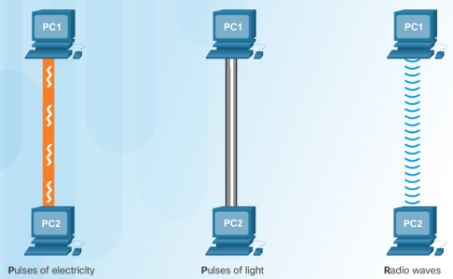
Communicating in a Connected World Transmitting Data on the Network
The Mighty Bit
Computers use binary codes to represent and interpret letters, numbers and special characters with bits.
Each group of eight bits, such as the representations of letters and numbers, is known as a byte.
Getting Bits Moving
Bits are transmitted as signals over copper wire (electrical pulses), fiber- optic cable (light pulses), and wireless (radio waves).
Notes:
1.1 – Communicating in a Connected World
1.1.2 – Transmitting Data on the Network

Slide 17
Communicating in a Connected World It’s All About the Speed
Measuring Bandwidth
Digital bandwidth is the amount of data that can flow from one place to another in a given amount of time measured in the number of bits that (theoretically) can be sent across the media in a second.
Measuring Throughput
Throughput is the actual measure of the transfer of bits across the media over a given period of time.
Many factors influence throughput including the amount of data being sent / received, the types of data being transmitted, and the accumulated latency created by the number of network devices encountered between source and destination.
Notes:
1.1 – Communicating in a Connected World
1.1.3 – It’s All About the Speed

Slide 18
1.2 Local Networks
Notes:
Cisco Networking Academy Program
Networking Essentials
Chapter 1: Ever Wonder How It Works?

Slide 19
Local Networks Network Components
Clients and Servers
Servers are hosts that have software installed that enable them to provide information, like email or web pages, to other hosts on the network.
Clients are computer hosts that have software installed that enable them to request and display the information obtained from the server.
Multiple Roles in the Network
Servers can provide multiple services in a network
Notes:
1.2 – Local Network
1.2.1 – Network Components

Slide 20
Local Networks Building Blocks of a Network
Network Infrastructure
This is the platform that supports the network containing end devices, intermediate devices (routers, switches, access points, …) interconnected using network media (wired and wireless).
End Devices
Includes computers, laptops, printers, tablets, smart devices, …
Form the interface between users and the underlying communication network.
Notes:
1.2 – Local Network
1.2.2 – Building Blocks of a Network

Slide 21
1.3 Building a Simple Network
Notes:
Cisco Networking Academy Program
Networking Essentials
Chapter 1: Ever Wonder How It Works?

Slide 22
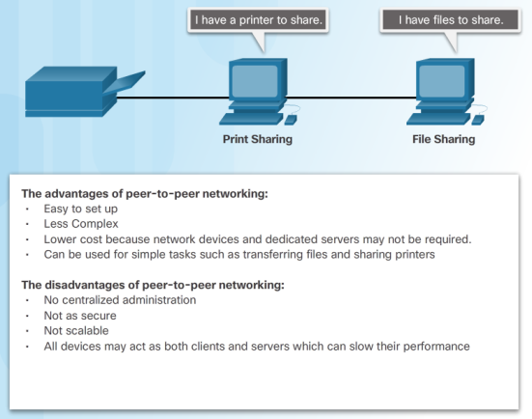
Building a Simple Network Peer-to-Peer Networking
What does Peer-to-Peer mean?
Network in which a host can be a client and a server for other hosts.
Notes:
1.3 – Building a Simple Network
1.3.1 – Peer-to-Peer Networking

Slide 23
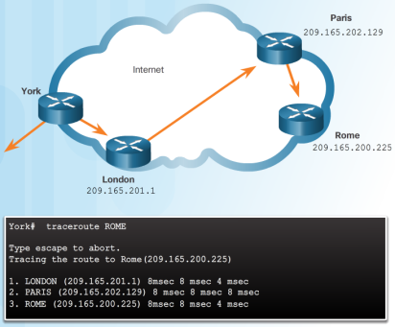
Building a Simple Network Does It Work?
Using the Ping Command
Use the ping utility to test end-to-end IP connectivity between a source and destination IP address.
Following the Path
Use the traceroute utility to display each hop in the path to the destination.
Notes:
1.3 – Building a Simple Network
1.3.2 – Does It Work?

Slide 25


